Slide 1

MODULe 1: iOS tutorials
Autores: Maria Herrera
Everton Peres

Slide 2
Location services tutorial

Slide 3
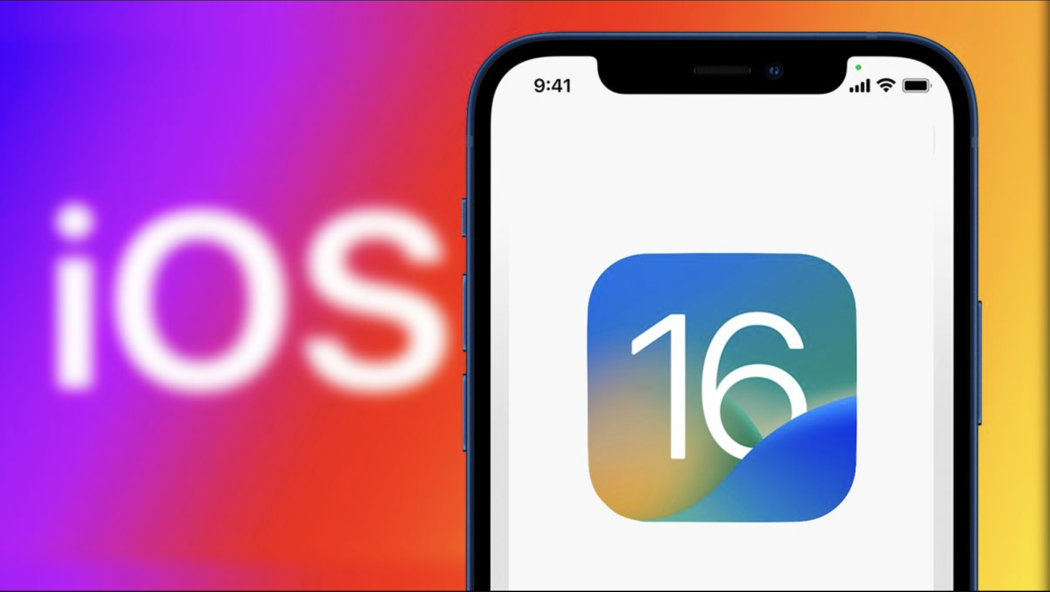
LOCATION SERVICES
According to information from Apple:
“Location services allow Apple and third-party apps and websites to gather and use information based on the current location of your iPhone to provide a variety of location-based services.”

Slide 4
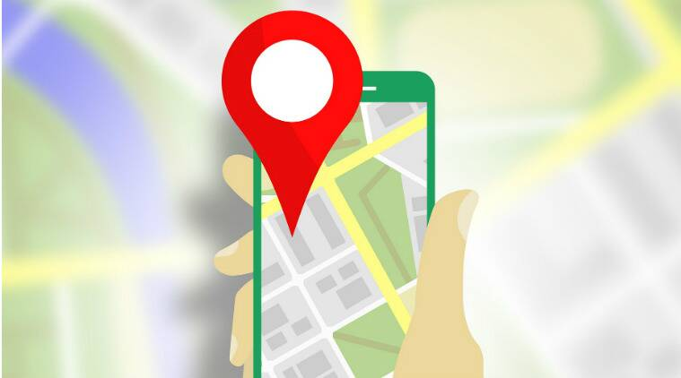
LOCATION SERVICES
These services on iOS allow Apple and third-party apps and websites to gather and use information based on the current location of your iPhone to provide a variety of location-based services.
Location services use GPS, Bluetooth and also location data obtained from Wi-Fi access points and from cellular towers to determine the approximate location of the device.

Slide 5
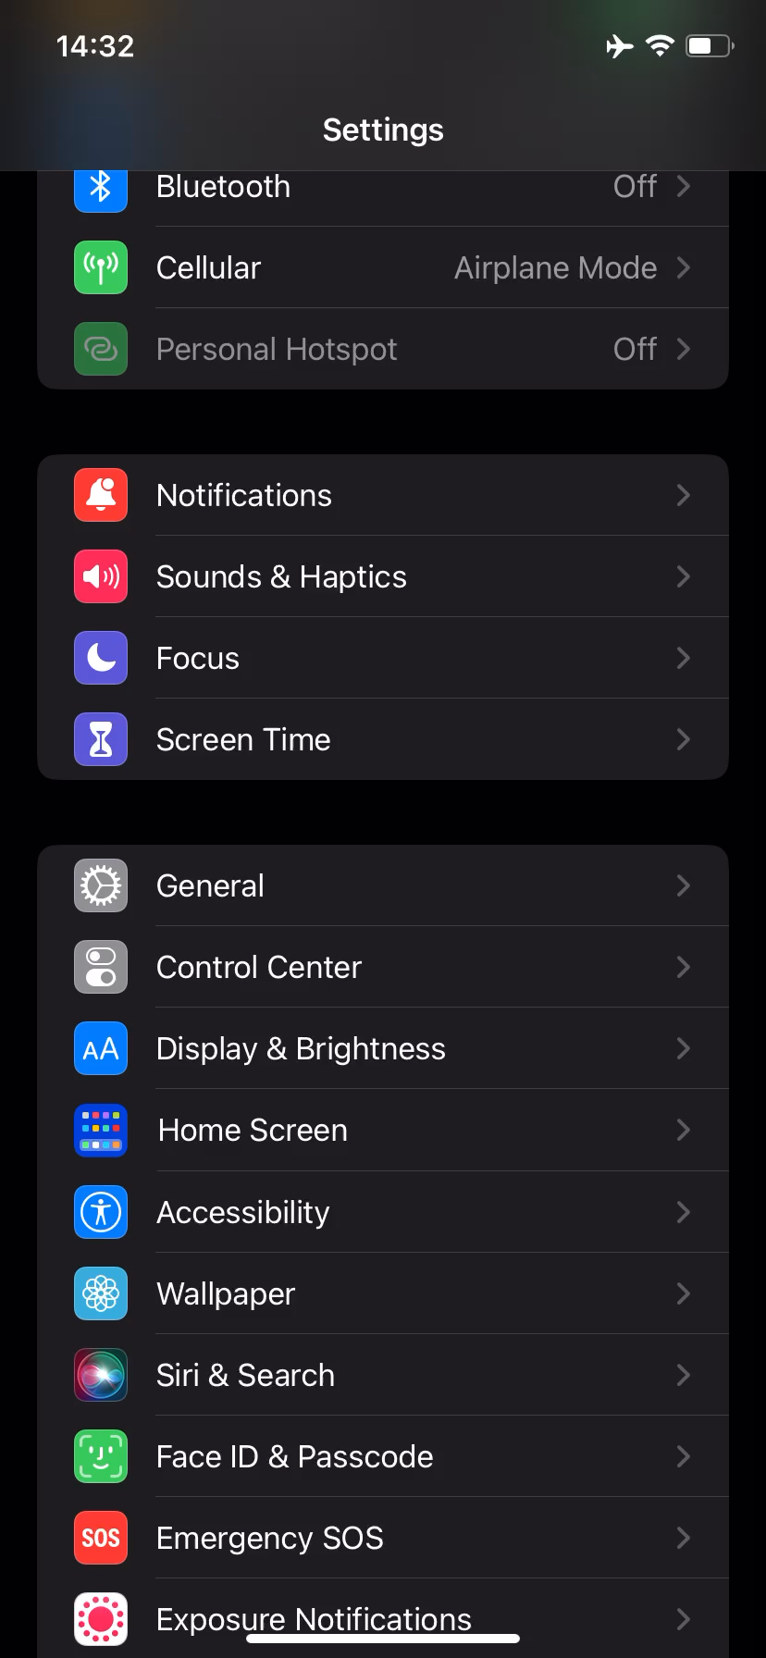
LOCATION SERVICES
To activate the location services, the following path must be followed:
Settings -> Privacy & Security -> Location Services

Slide 6
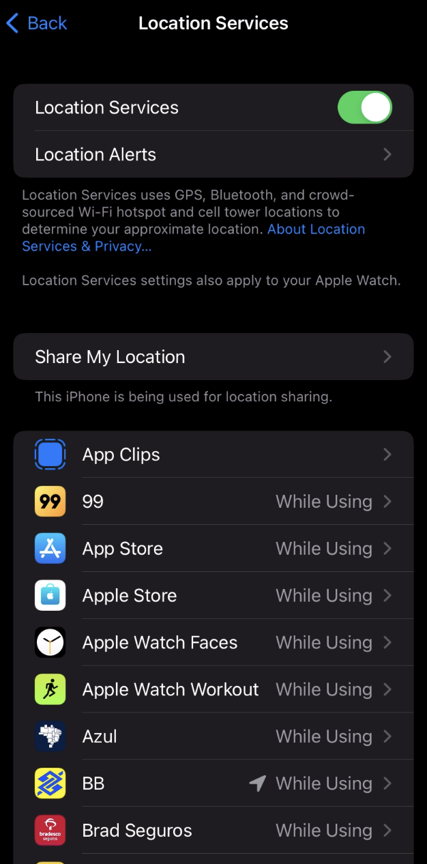
LOCATION SERVICES
A list with all the installed apps that use Location Services feature is available on the same section of the Settings application for the user to allow access individually for specific apps with the following options:
NEVER;
ASK NEXT TIME OR WHEN I SHARE;
WHILE USING THE APP;
ALWAYS.

Slide 7
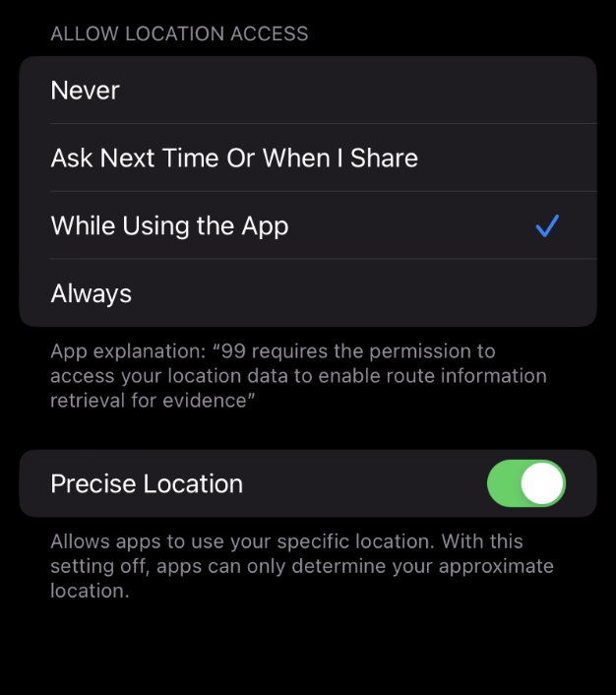
LOCATION SERVICES
Bellow these options, there will be a brief explanation about the reason why the particular app wants to use location settings.

Slide 8
CONTROL CENTER SETTINGS – find my phone.

Slide 9

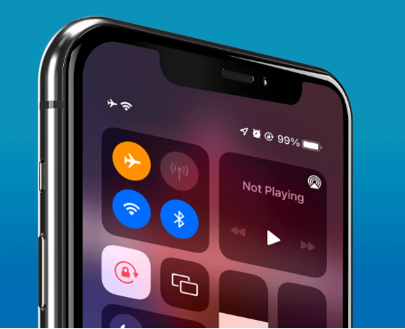
Prevent THIEVES FROM TURNING ON YOUR IPHONE’S AIRPLANE MODE
When an iPhone is lost or stolen, it's imperative to start tracking it via Find My as soon as possible. However, if it's stolen, there's a good chance the thief or robber turns on Airplane Mode (accessible from the swipe-to-open Control Center on the lock screen), blocking all communication with the iPhone. If this is a scary thought, you can prevent thieves from accessing Airplane Mode altogether.

Slide 10
A simple solution is to disable access to it from the lock screen when locked

Slide 11
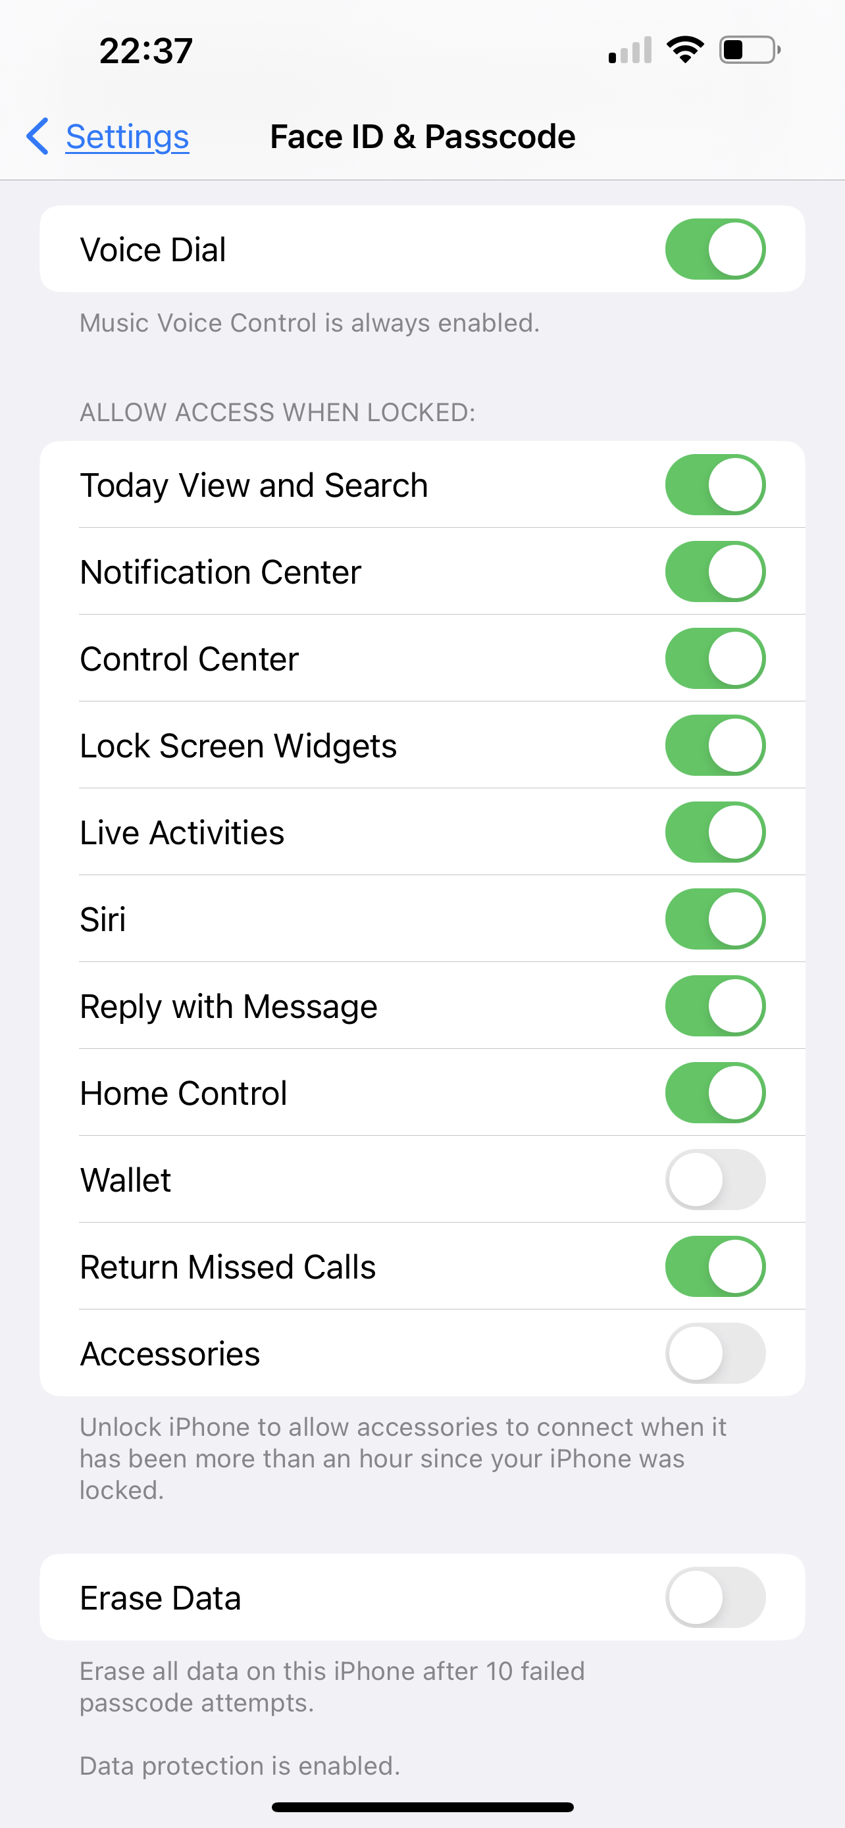
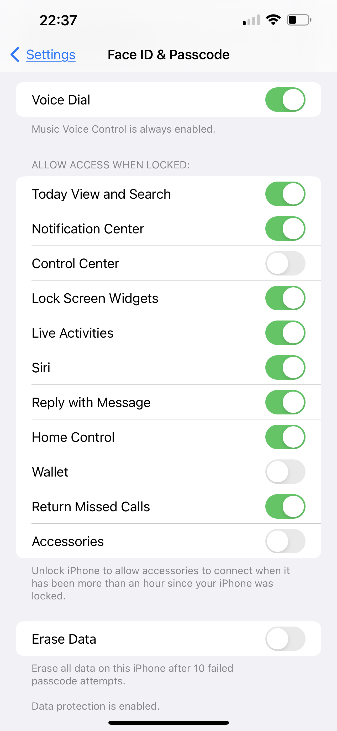
Scroll down and toggle off the "Control Center" switch under the Allow Access When Locked header.

Slide 12
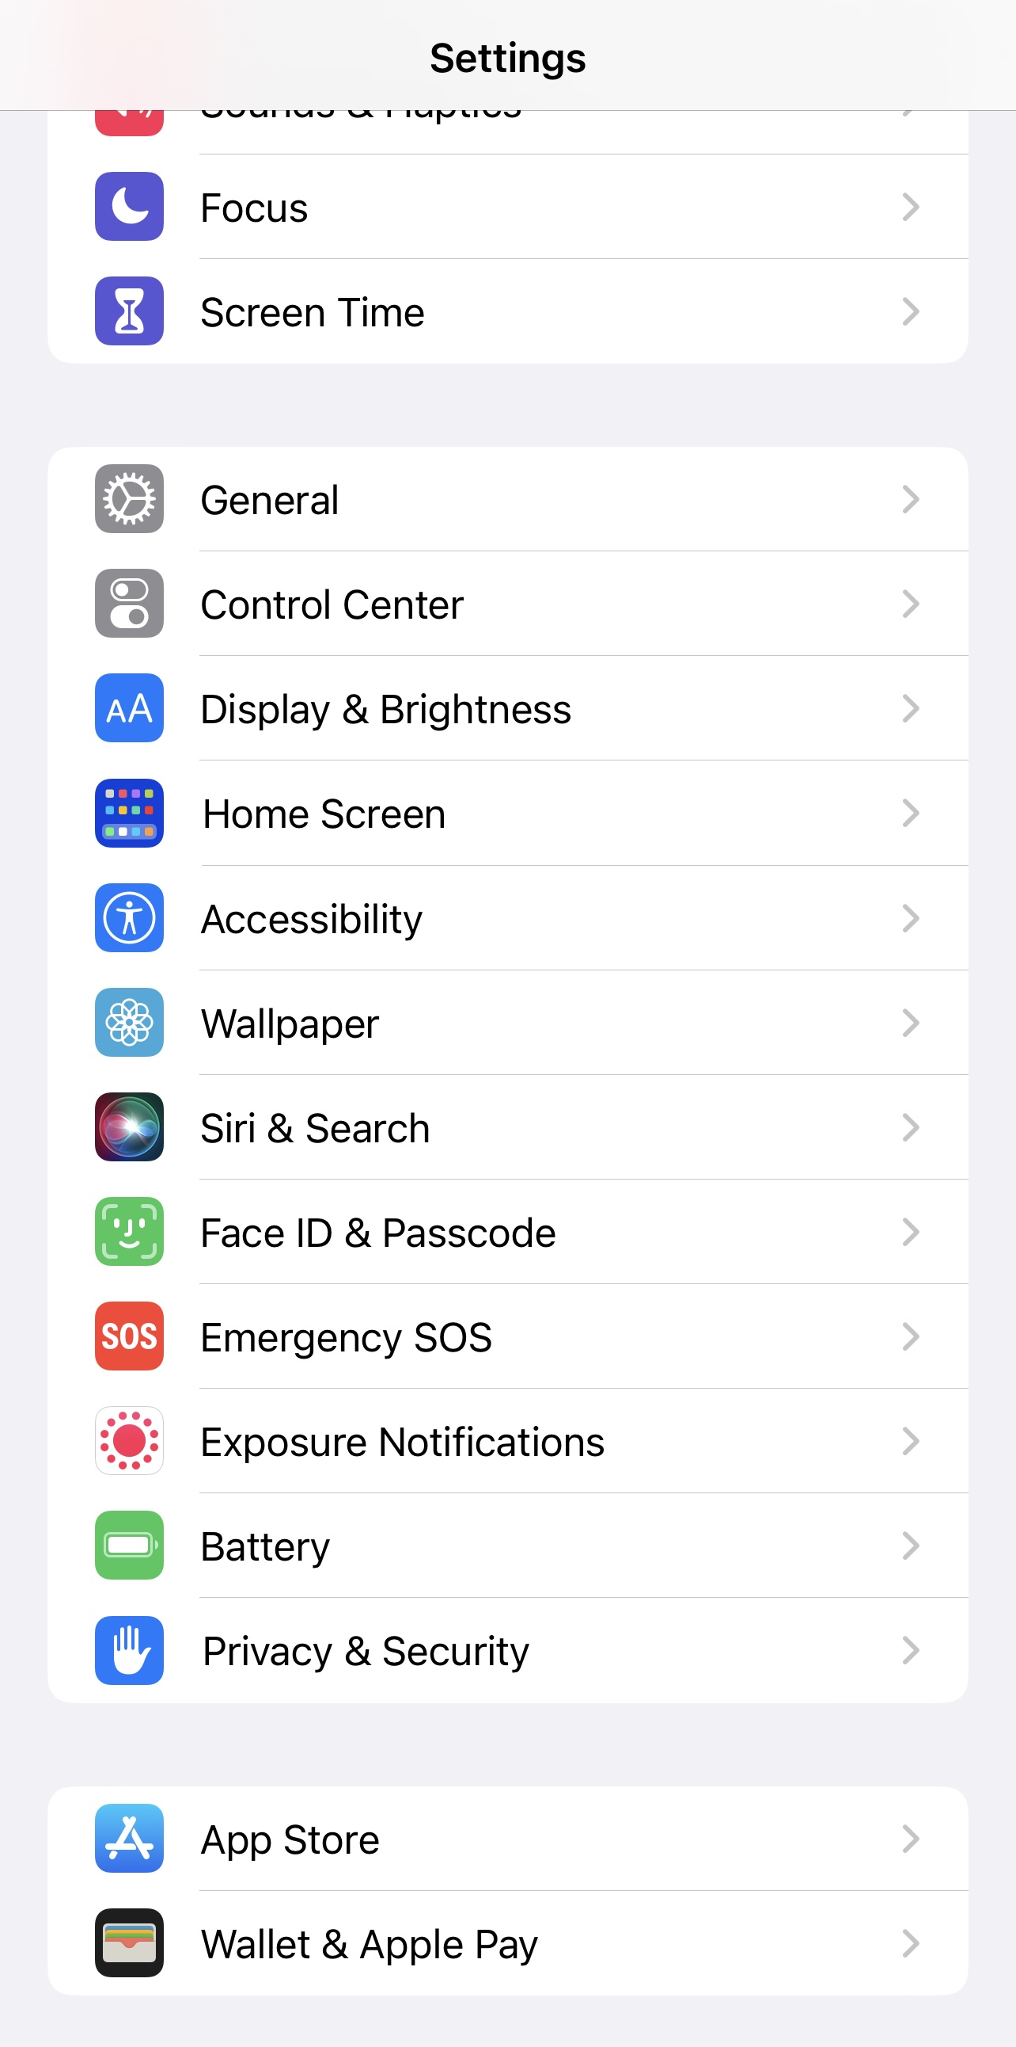
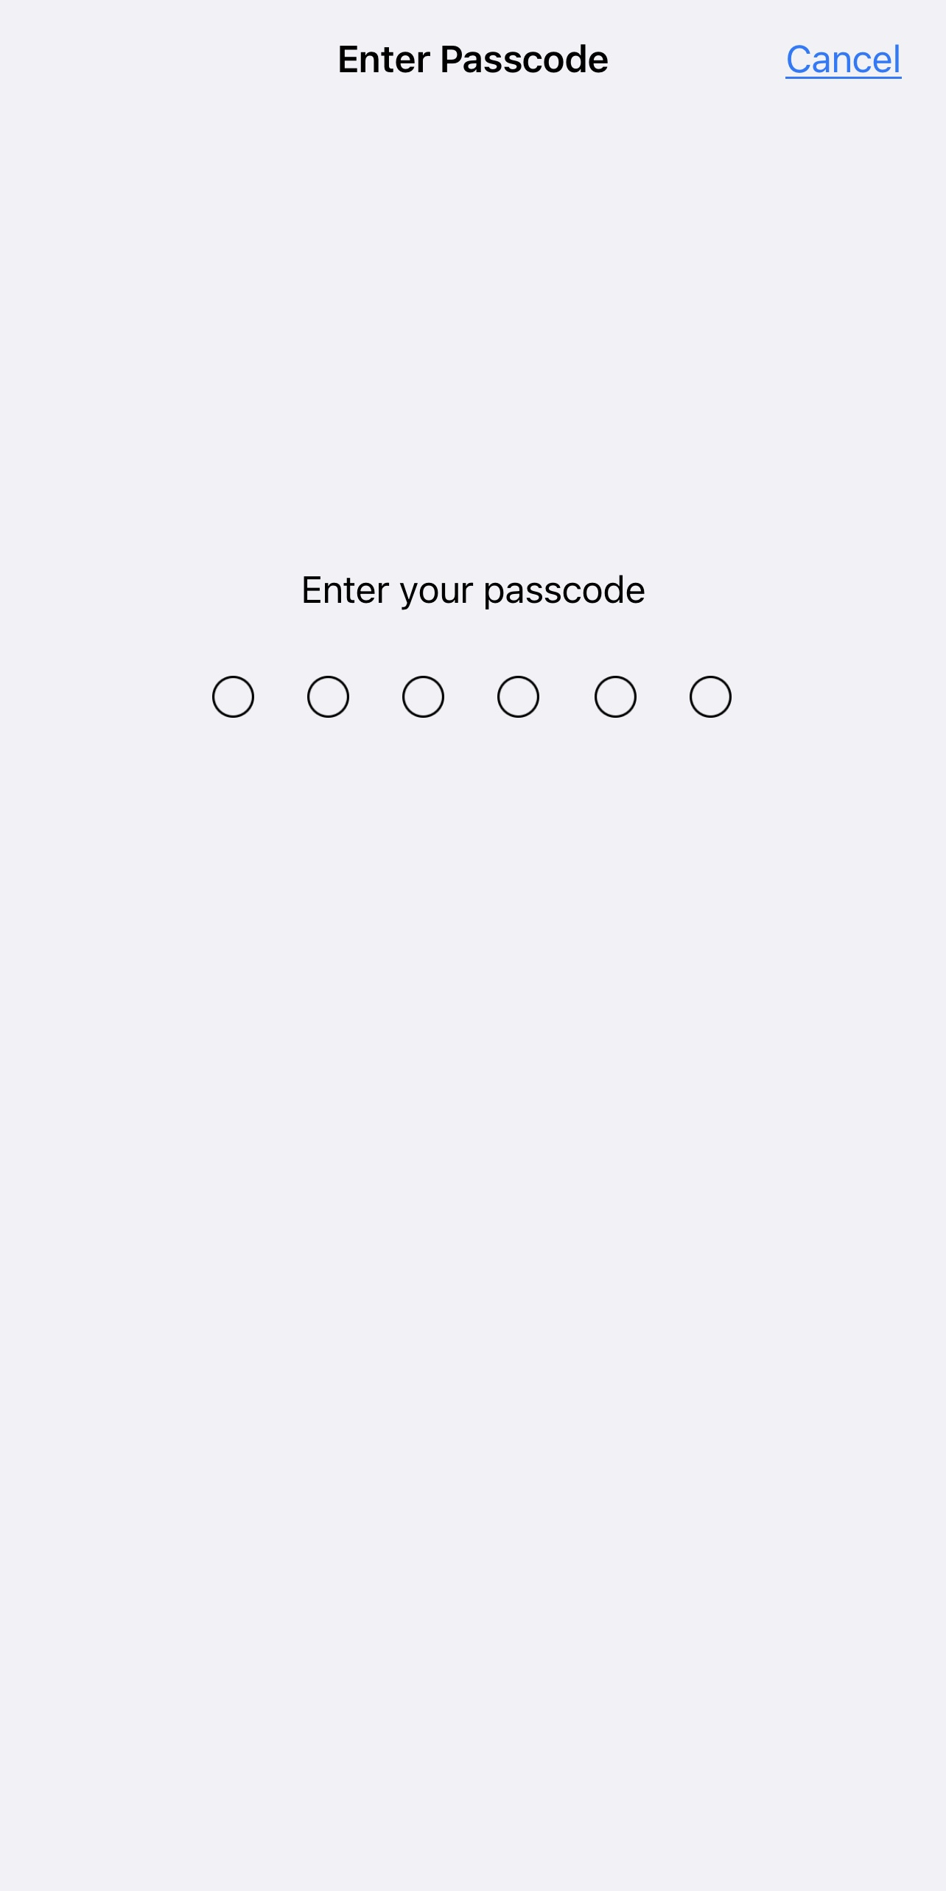
Disable Control Center from Lock Screen
You must stop accessing the Control Center on your lock screen. To do so, launch the Settings app, go to "Face ID & Passcode," then enter your iPhone's passcode when prompted.

Slide 13
APPLE PAY SETTINGS

Slide 14
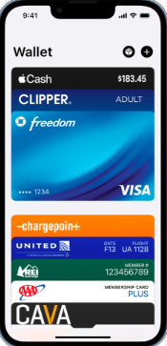
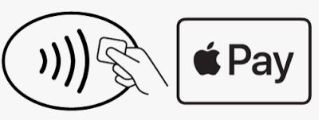
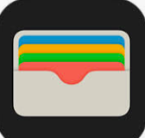
APPLE PAY SERVICES
With your Apple Cash, credit, and debit cards stored in the Wallet app iPhone, you can use Apple Pay for secure, contactless payments in stores, restaurants, and more.

Slide 15
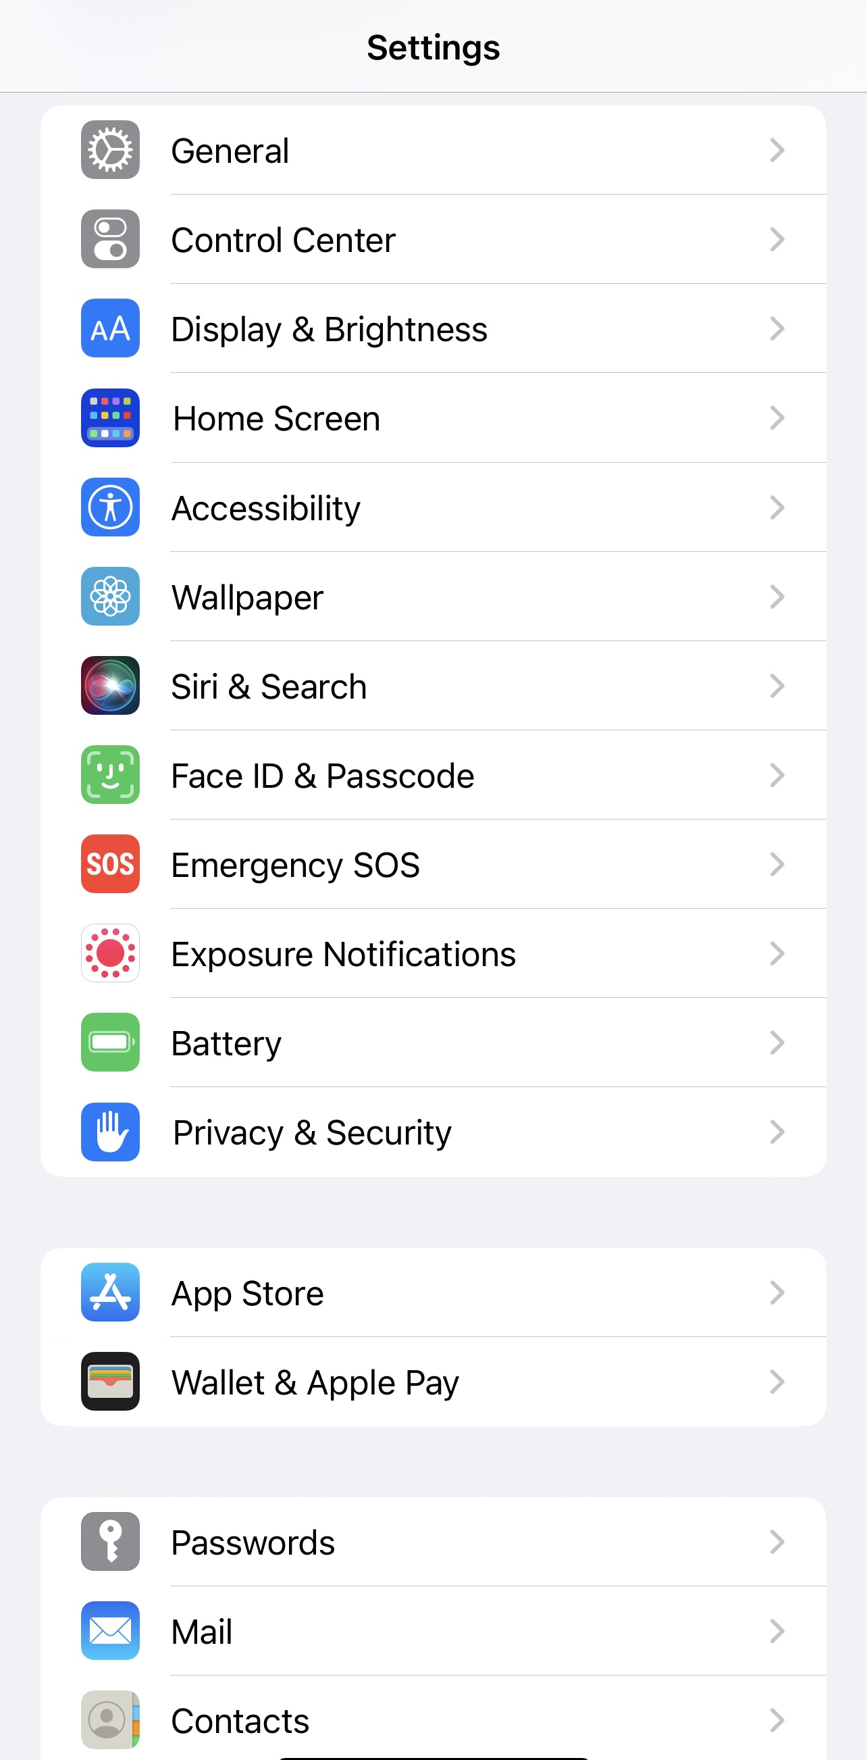
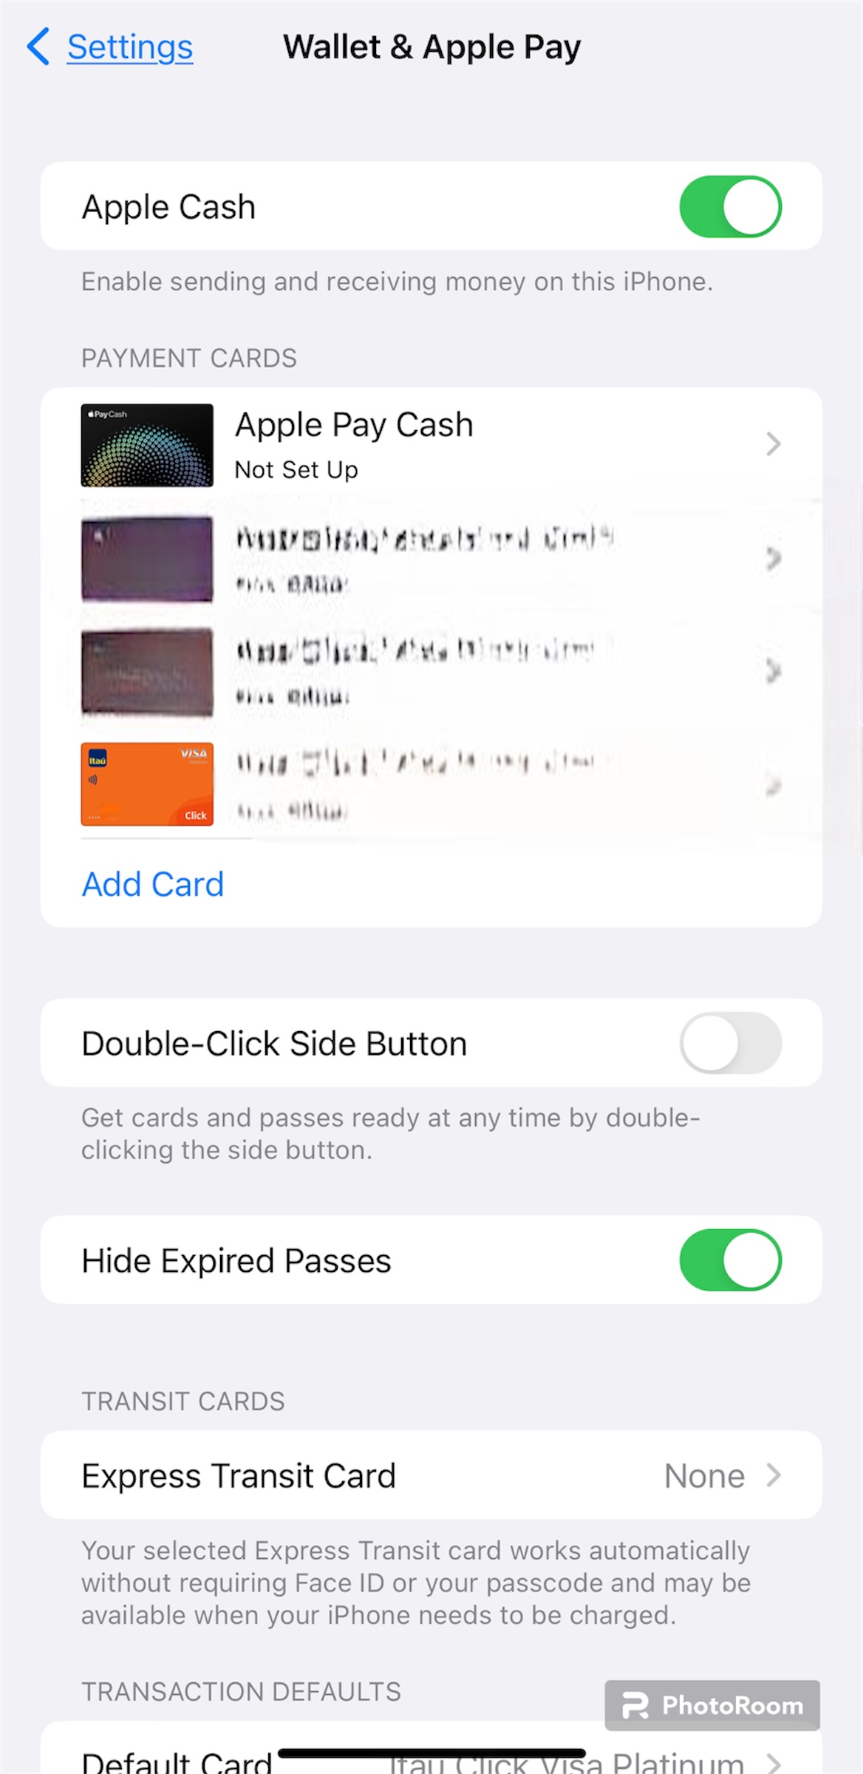
STEP 1: Set up Apple pay in the wallet app
1
1. Open the Settings app on your iPhone.
2. Then tap Wallet & Apple Pay.
3. Next, tap Add Card. You may be asked to enter your Apple ID and password.
3
2

Slide 16
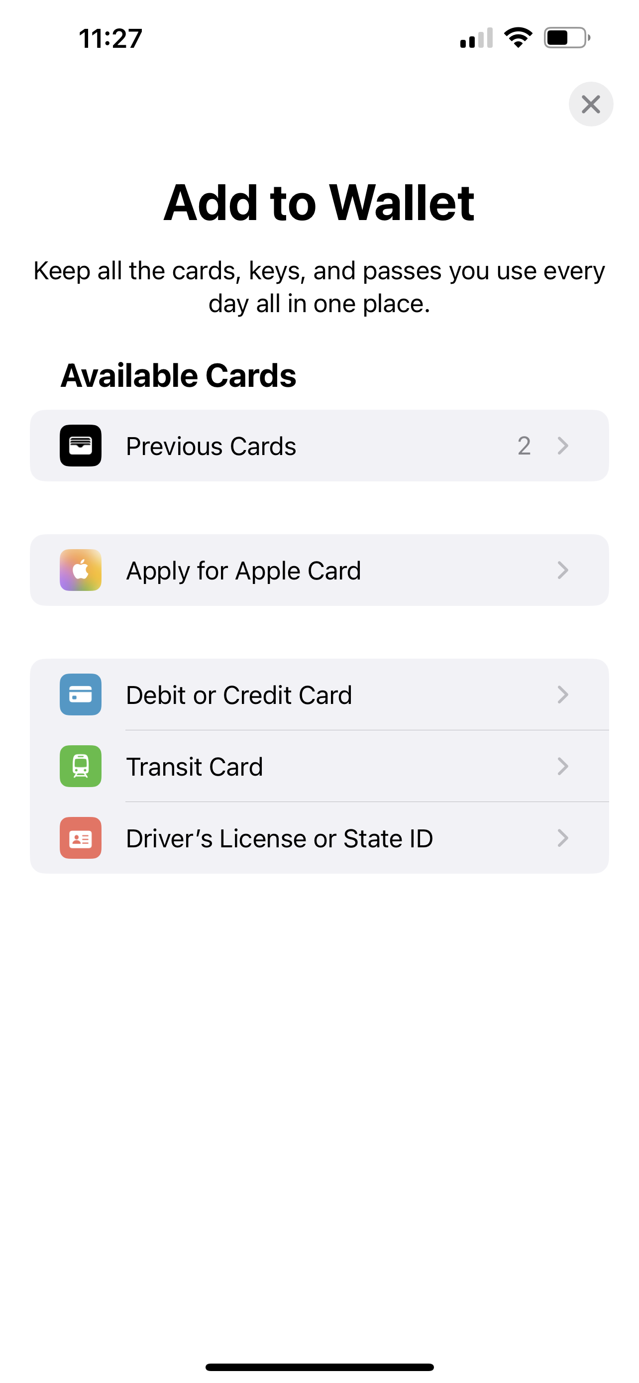
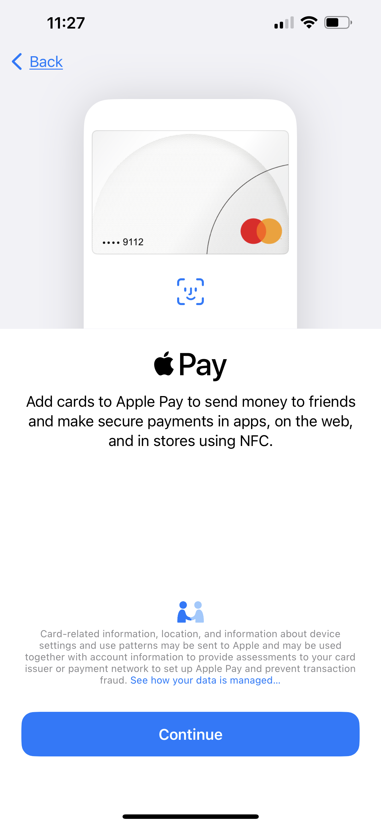
STEP 2: Tap on the Add Card button and enter info
4. Then tap Credit or Debit Card.
5. Next, tap Continue.
6. Enter card details.
7. Verify your card with your bank.
4
5

Slide 17
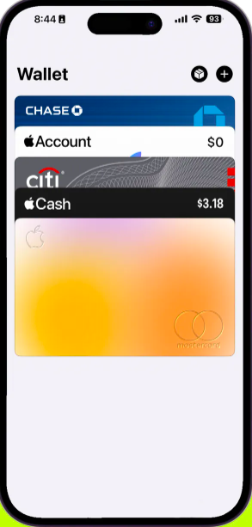

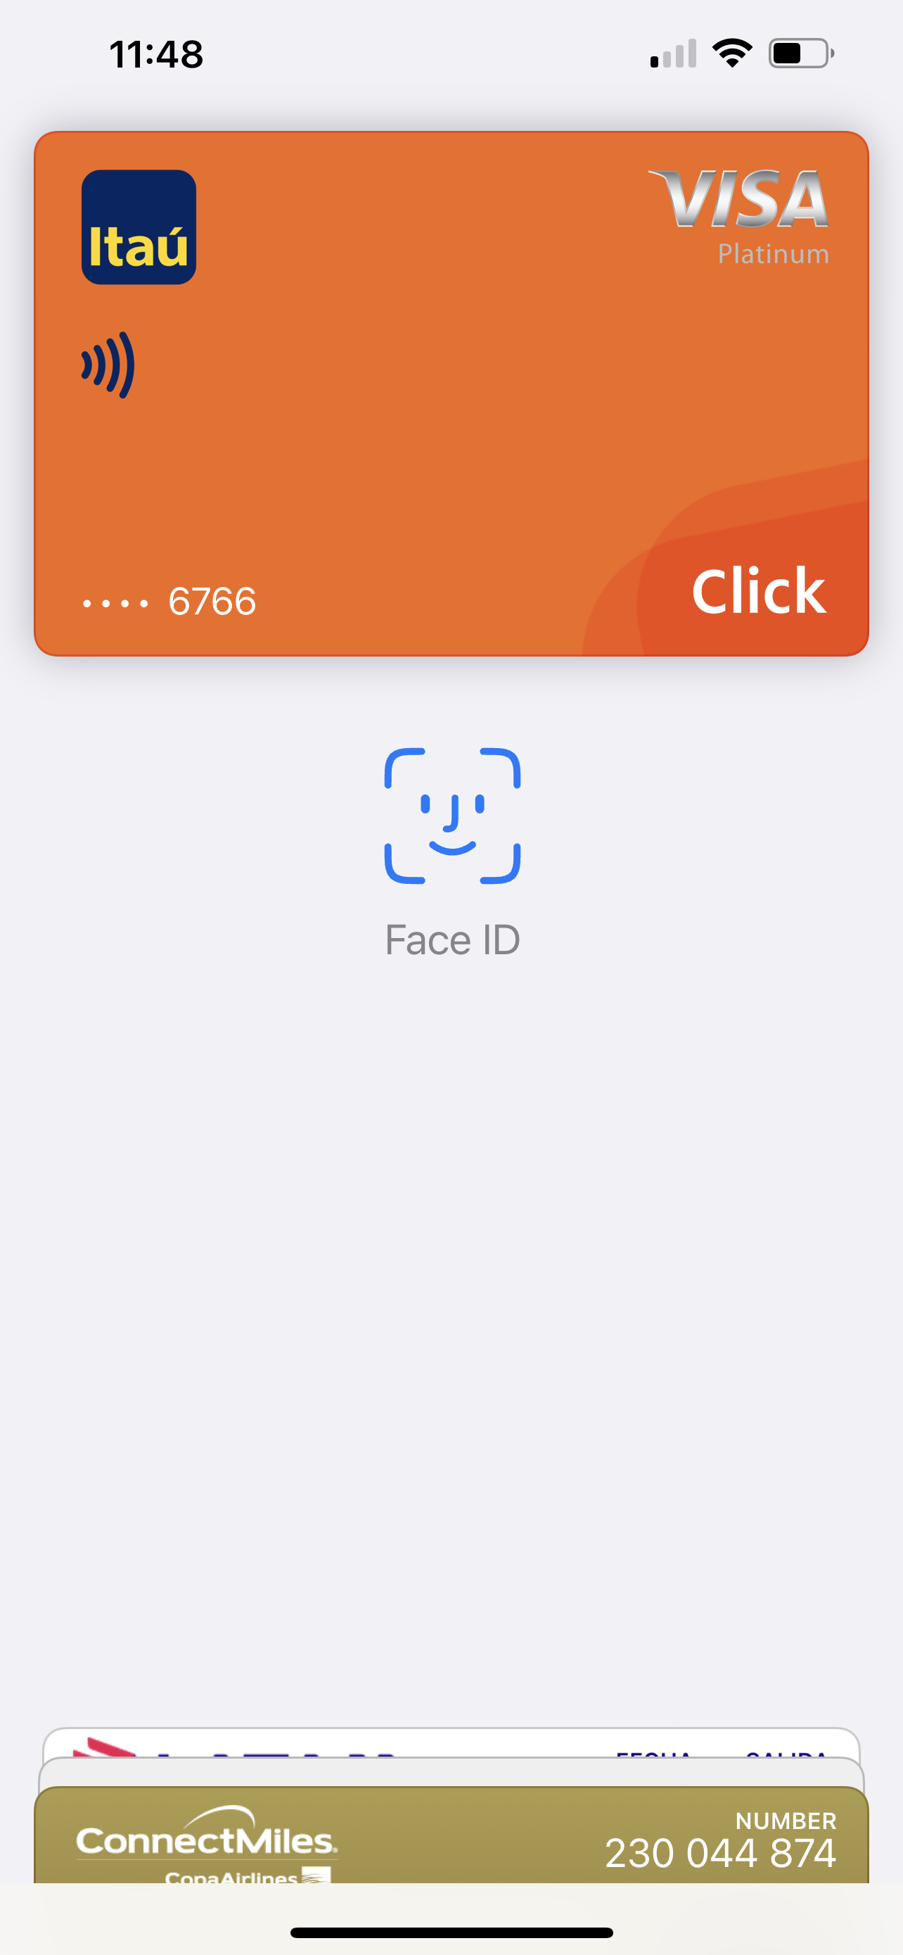
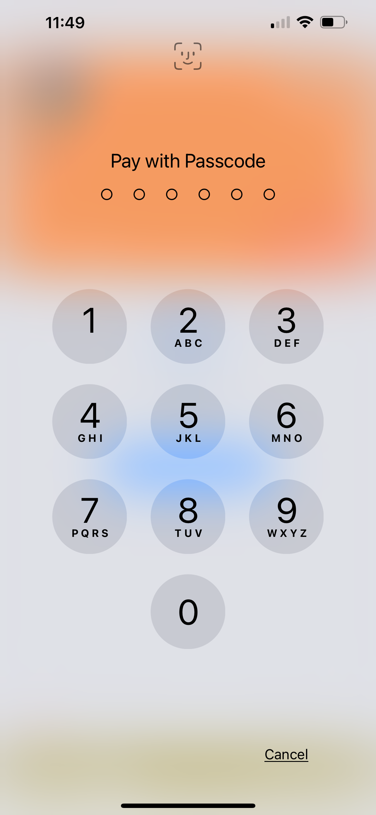
STEP 3: How to use Apple Pay in stores
1. CardDouble-press the side button or the Home button on your iPhone.
2. Then use Face ID or Touch ID or Passcode to verify your identity
3. Finally, hold the top of your iPhone over the card reader.

Slide 18
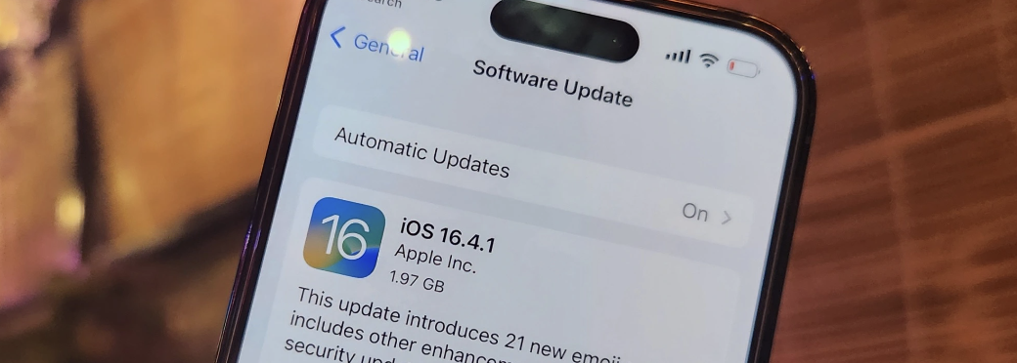
Remember to keep your iOS Always up to date to ensure security features are efficient.

Slide 19
Thank you!

